Slide 1
A.O.K Laptop System Overhaul
Deliverable 2
Presented by: Alex Varghese, Omar Al-Hedari, Upen Adhikari, Ralu Ofoche, Nima Roomi

Slide 2
Functional Requirement (Process) Part 1
Requesting the laptop - First the user must request a laptop in person, online, or through the mobile app
Patrons that Requests that are not in person will only be reserved laptops (missed appointments will cancel reservation)
Must choose between 4 hour rent or 3 day rent period (depending on availability)
ID, laptop, and charger will all be scanned at desk
Pictures will be taken of the laptop (saved with the patron’s name and whomever loaned them the laptop )

Slide 3
Functional Requirement (Process) Part 2
Returning the laptop:
The patron must return the laptop, charger, and bag
ID of Patron, Laptop, and charger will be scanned
Picture taken during check-out of laptop will be referenced when returning it
If necessary, charges will be applied

Slide 4
Functional Requirement (Process) Part 3
Reserving a laptop:
The Patron will request a time for their pickup of their laptop of choice
Patron must pick up the laptop on time
If laptop is not picked up 15 minutes after requested pick up time, the reservation will be cancelled

Slide 5
Functional Requirement (Information)
System will keep a record of all past and current transactions of every patron
System accessed through web browser needs retain all info such as
FAQ
Online help
Laptop details/Quantity
For mobile App: System must provide instructions for
SignUp/SignIn
Request help
Reserving a laptop (with policies/terms & conditions)
*App should also keep records of the expenses from damage/depreciation for current and past years

Slide 6
Non Functional Requirements Pt 1
Operational:
Will be able to run on any phone OS (Windows, Android, IOS)
It will optimize the process of borrowing a laptop and decrease the need for in person requests
Will be integrated into current systems that library uses for checking out laptops such as ALPEH
Client’s are reliable with minimal crashing and bugs
Intuitive for easy troubleshooting and understanding

Slide 7
Non Functional Requirements Pt 2
Performance:
Mobile app will need a server to connect to reserve a laptop, which should be available 24/7
The server should support a minimum of 200 simultaneous requests
The server will be hosted by UMBC for fast local access for Patrons on campus network
Potential reliability issue if UMBC power or network goes down
The employee client should provide fast query times for logs 30sec<
Data is regularly backed up for disaster recovery

Slide 8
Non Functional Requirements Pt 3
Security:
System must address security threats/issues to keep data private
Mobile app users must be registered to use services
Uses myUMBC login and authentication (will be verified by the system)
Only library staff may access the web app that stores the loaned laptop information and pictures for damage inspection
Will protect personal data of patron and will provide safety against hacking, trojans, and viruses

Slide 9
Non Functional Requirements Pt 4
Cultural/Political:
The mobile app will be multilingual so that it is easier to use for students who don’t have English as their first language
Easily adjustable for multiple languages due to diversity of the student population
Laptop identification and photo process should feel unobtrusive
The patrons should not be offended.

Slide 10
Interview Information
Name of Interviewee: Paula Langley
Position: Library Manager
Interviewer: Omar Al-Hedari
Questions:
Do students usually rent in-person or online?
What laptop do you usually rent out? And why?
How long does the student usually rent out and how does the late policy work?
Have there been any issues with the laptops that have rented out?
If they reserve the laptop via the library website, do they find it convenient in doing so?
What other methods that students use to get a laptop when it is a rush hour?

Slide 11
Interview Information Ctd:
Answers:
Library rules require patrons to be physically present when borrowing library materials.
Items we loan are listed here http://lib.guides.umbc.edu/c.php?g=961173
To allow for resource sharing, we loan the Dells, Macs, and ½ of the Chromebooks for 3 days (up from 1 day in previous semesters to accommodate patrons and also in response to a survey we conducted last spring where patrons who used the service commented that a longer loan period is desirable.
Patrons claim they are not informed of due dates, fail to return items when they are due, When technical issues are identified, DoIT fixes the issue or have the device replaced. The biggest issue is that we do not have enough devices to loan to the students who need a laptop.
Hopefully. I’ve noticed that turnaround time is less than 24 hours.
In previous semesters, students would solicit the aid of a friend to take turns borrowing a device rather than returning it. This made it less likely for others to have the opportunity to use the device. Now that we have allowed holds on the laptops when others are waiting for a device to become available, patrons can no longer trade the loan with a friend. They must return the laptop and join the queue if they so desire

Slide 12
Interview Information Ctd:
Name of Interviewee: Beverly Conner
Position: Student Manager
Interviewer: Ralu Ofoche
Questions:
Do students usually rent in-person or online?
If you use online what are your opinions of the library website?
What laptop do you usually rent out? And why?
How long does the student usually rent out and how does the late policy work?
How do they handle rush periods
What would you change about the renting out process

Slide 13
Interview Information Ctd:
Answers:
It is a transition this semester. Students are just learning that they can do it online. They usually come in. The students usually find no computers in so they are starting to use the website. The 4 hour Chromebooks are sometimes in and there are 10.
I think it is pretty streamlined but the first time it’s not as streamlined. After the first step of the process, people are having some issues. Usd to say how many were available, but coder left with his knowledge. Now there is only a redirect page.
All of them. Some like the different properties. Personal preference. I am personally a dell person. Different students in different majors use different laptops.
The time period is 3 days and 4 hours. Some are early and late. There are late fees applied. Students are usually on time and if they are late there are late fee appeal forms. Sometimes they are lucky and get the fee reduced or waived, but generally, it is a no and they have to pay.
If there is no one is available they go one at a time

Slide 14
Interview Information Ctd:
Answers CTD:
-The issue is that we do not have enough, and the department that pays for them say that they are expensive. As Well as the warranty. If no one is on the reservation list for a laptop, the student can rent it out again, e.g. renting out for 6 days instead of 3.
-The different reservation lists do not communicate with each other; if one person puts their name on three lists and gets a laptop they did not want, they either have to put up with it, or give back the computer and then re-add their name to another list because when you add your name to multiple lists, they remove it and leave your name on one.
-“It would be great if the website told you how many were available before you were redirected to the reservation page.”

Slide 15
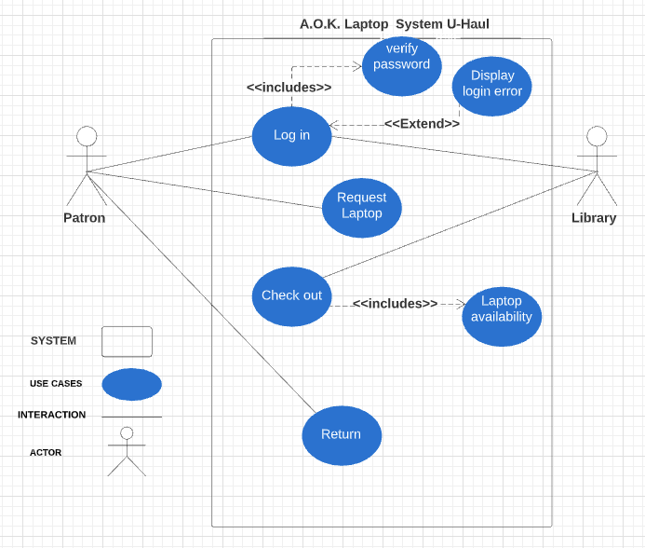
Use Case Diagram

Slide 16
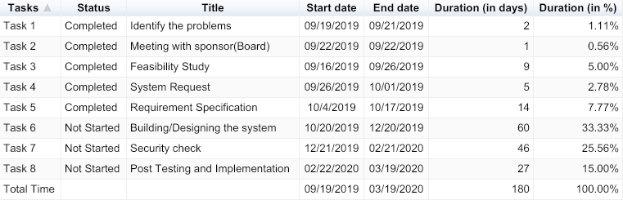
Work Plan/Project Plan

